Slide 1


Python – Class, Objects

Slide 2
Highlight
Class, object – what is it!!??
Accessing class and object.
Different OOP concepts.
Exercises.

Slide 3
Whats next …..
Plain code
Class
Code in functions
Object₁
. . . . . .
Object_{n}
Code in class and functions (OOP)

Slide 4
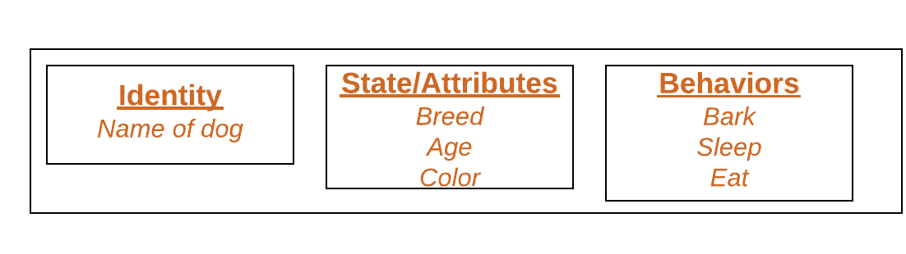
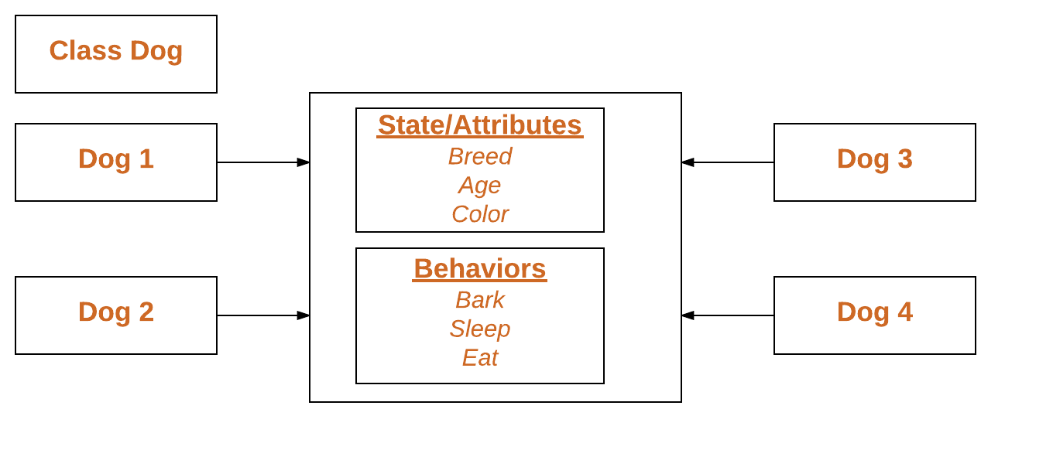
Class, Object
Object

Slide 5
Creating class and object
class class_name:
color = “brown“
def func( )
object_name = class_name ()
print (object_name.color)
object_name.func( )

Slide 6
Example Code
# instantiating a class
class Animal:
# A simple class attribute
attr1 = "mammal"
attr2 = "dog"
# A sample method
def func(self):
print("I'm a", self.attr1)
print("I'm a", self.attr2)
# Driver code
# Object instantiation
Rodger = Animal()
# Accessing class attributes# and method through objects
print(Rodger.attr1)
Rodger.func()

